Slide 1
3D FIRE Implementation

Slide 2
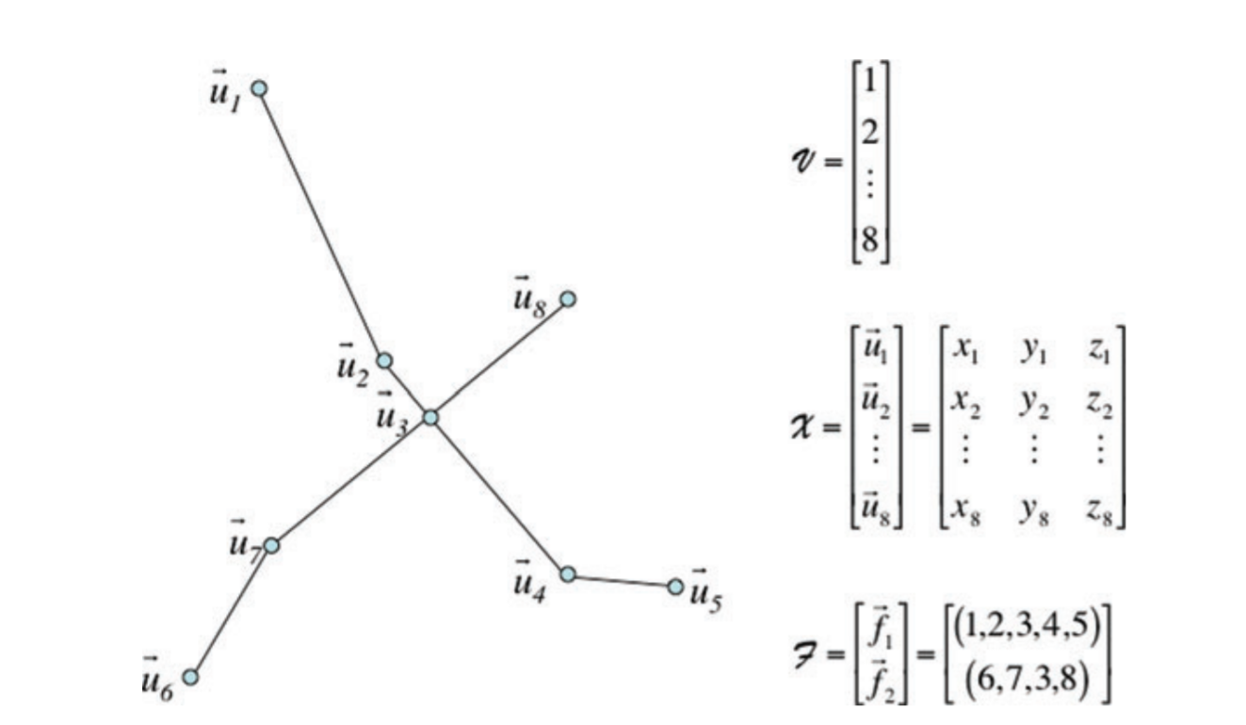
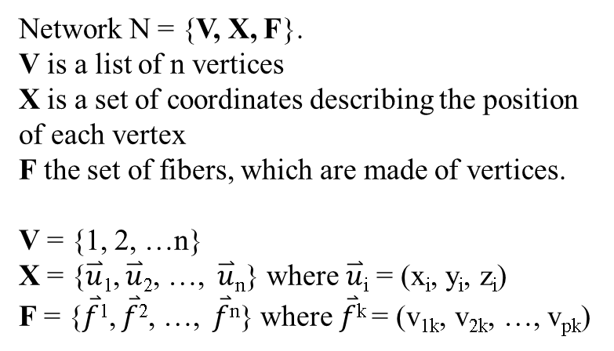
Abstract problem definition
Network N = {V, X, F}.
V is a list of n vertices
X is a set of coordinates describing the position of each vertex
F the set of fibers, which are made of vertices.
V = {1, 2, …n}
X = {$\overset{⃑}{u}$₁, $\overset{⃑}{u}$₂, …, $\overset{⃑}{u}$_{n}} where $\overset{⃑}{u}$_{i} = (x_{i}, y_{i}, z_{i})
F = {$\overset{⃑}{f}$¹, $\overset{⃑}{f}$², …, $\overset{⃑}{f}$^{n}} where $\overset{⃑}{f}$^{k} = (v_{1k}, v_{2k}, …, v_{pk})

Slide 3
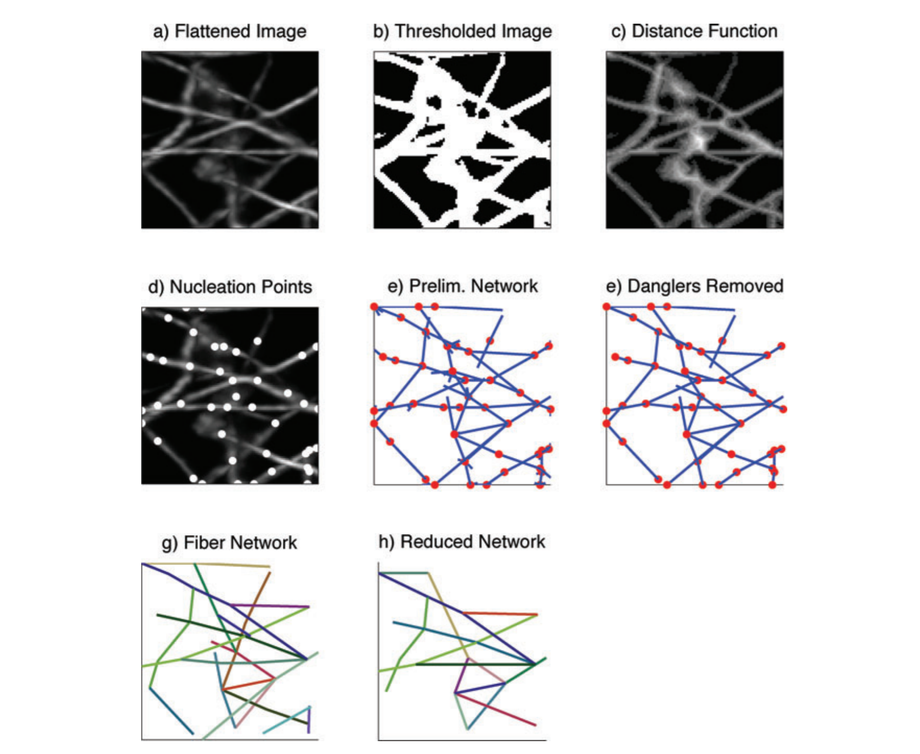
Existing CT-FIRE Algorithm
Flatten z-stacks along the axis perpendicular to focal plane.
Binary threshold on the image, into foreground vs background. Use relative intensity of pixels
Determine the minimum distance of each foreground pixel to the background. Apply a Gaussian filter.
Select nucleation points in the image to be the pixels with the maximum distance values.
Find the local maximum points (LMPs) of each nucleation points in a similar fashion. Continue to build the network until no more LMPs are found.
Remove short dangling fibers.

Slide 4
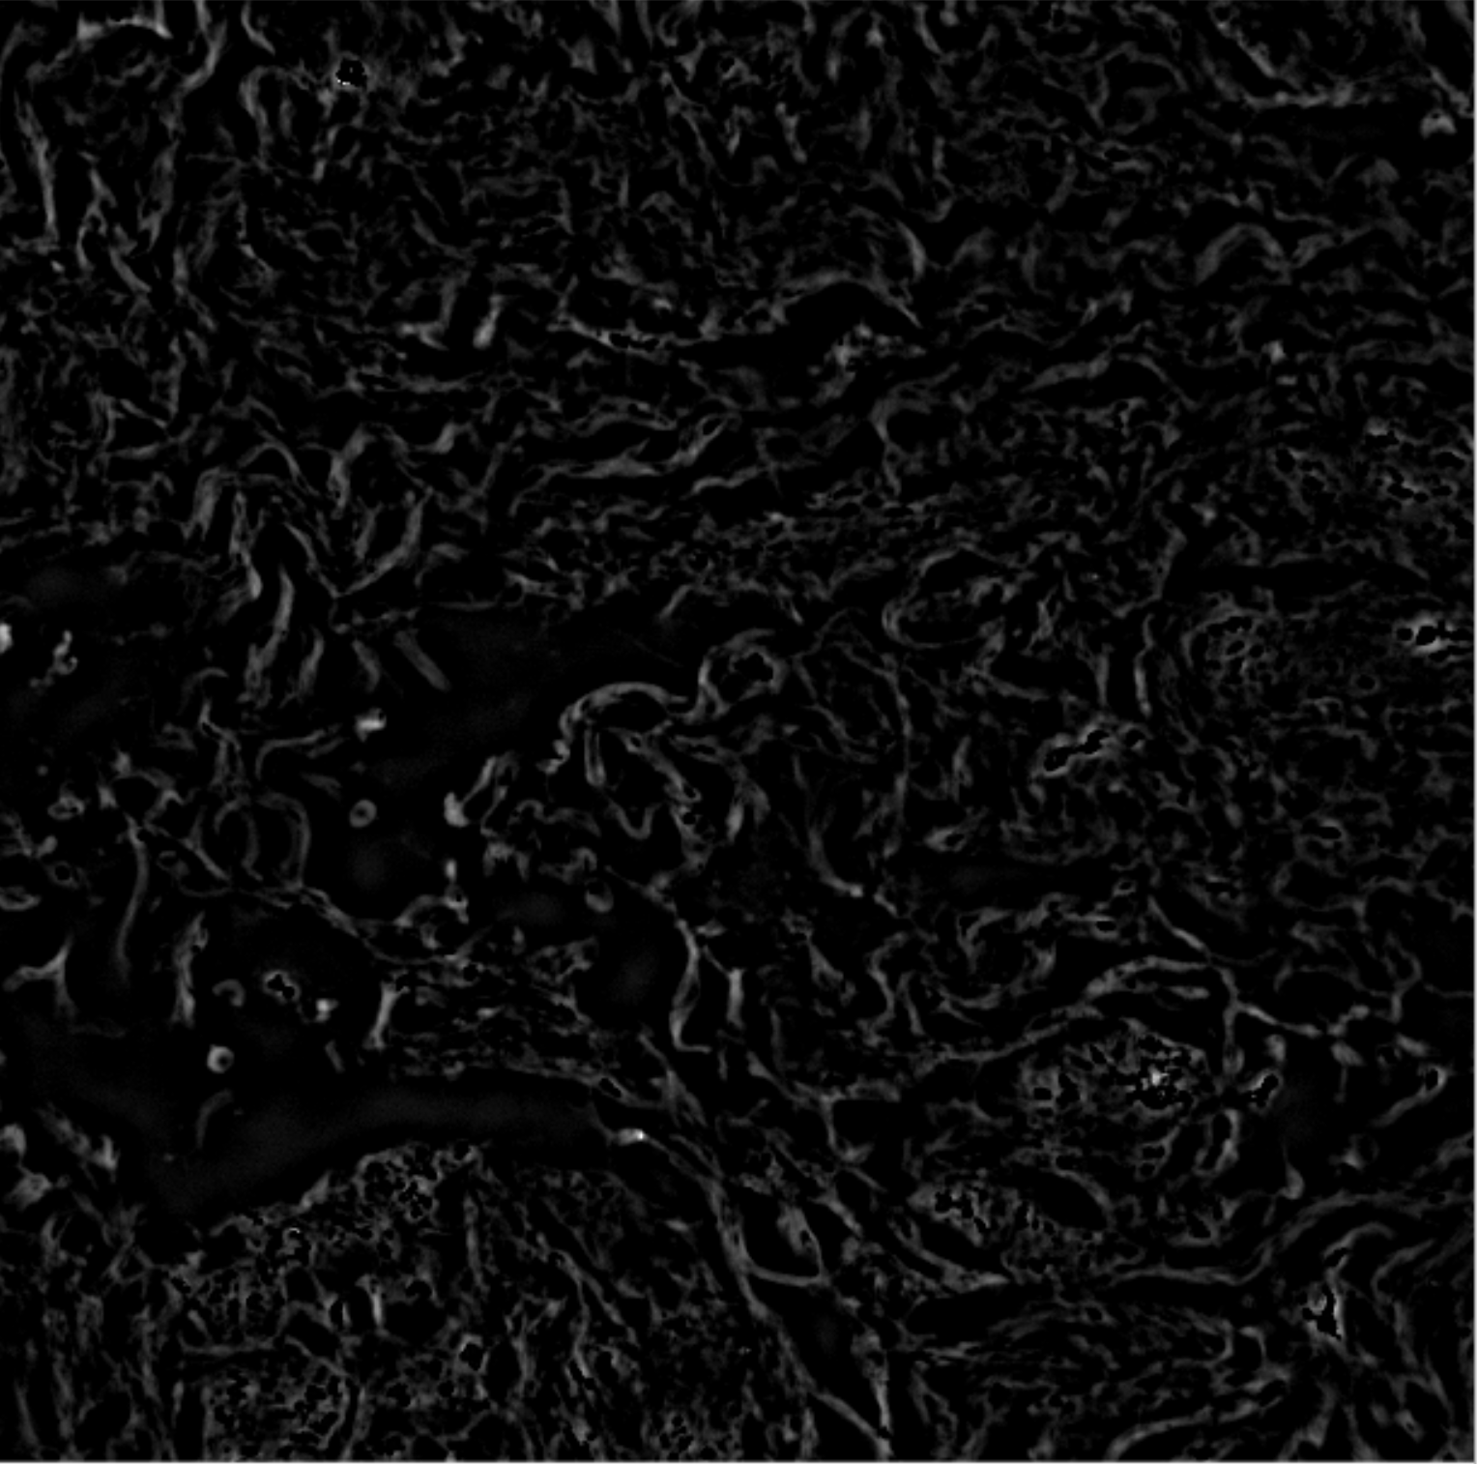

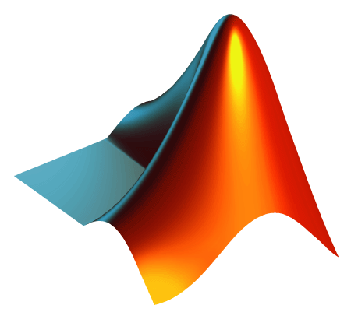
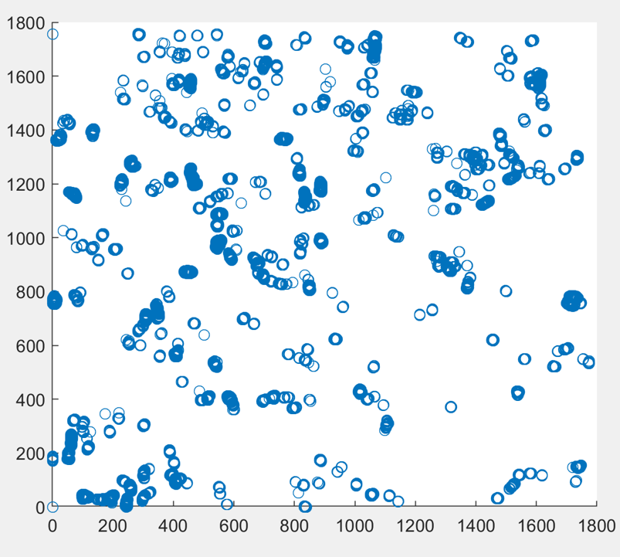
Technical Implementation
Zee-stack of images
3D Fire Algorithm
Return fibers to MATLAB for processing
Fiber visualization

Slide 5
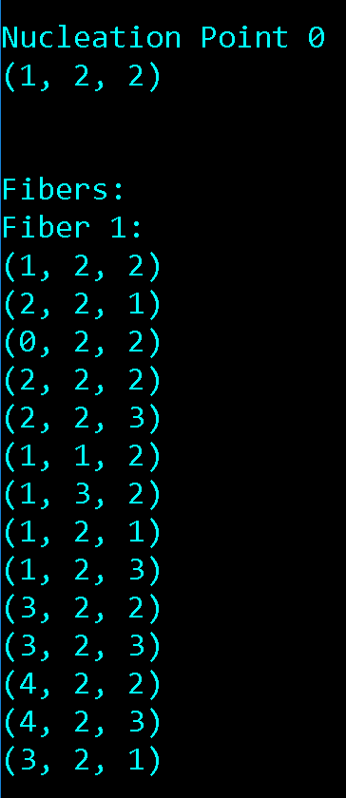
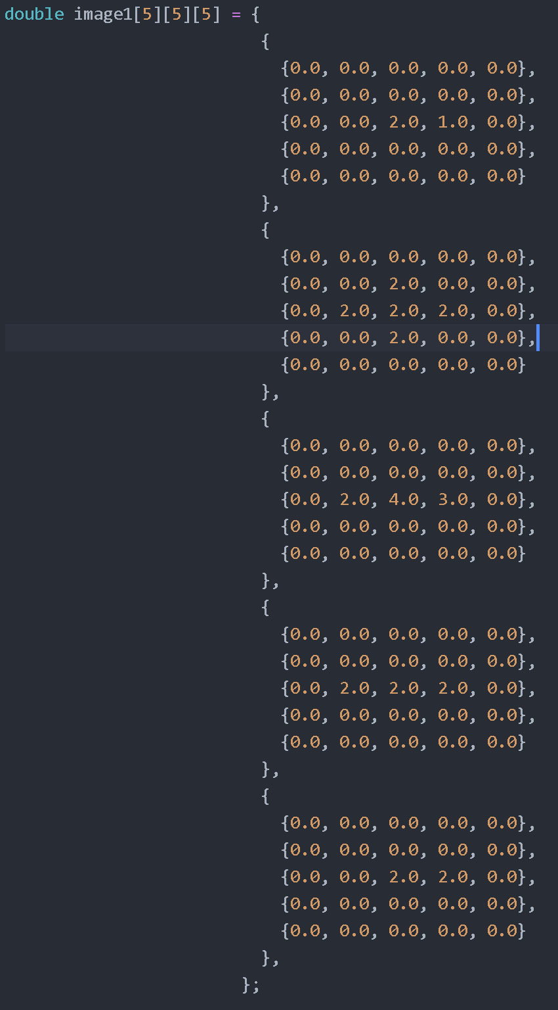
Single fiber in Z direction (cube)

Slide 6
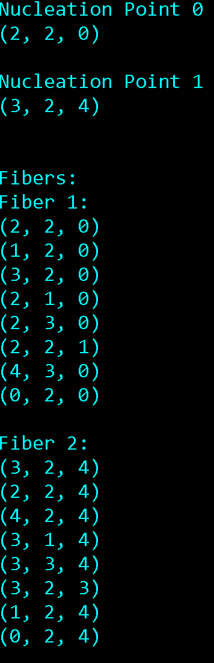
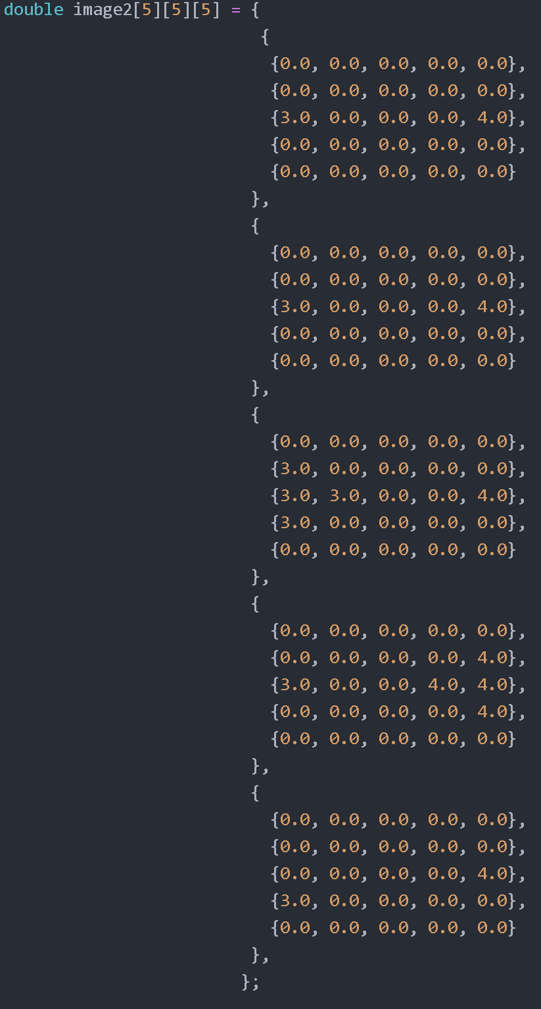
Two fibers in Z direction (cube)

Slide 7
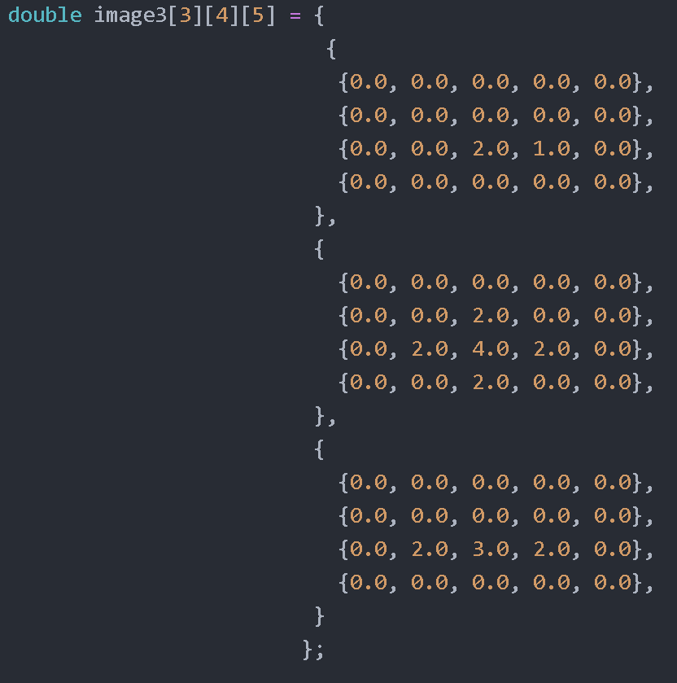
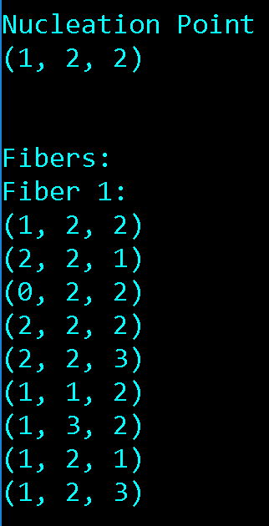
Non-cube images with one fiber

Slide 8
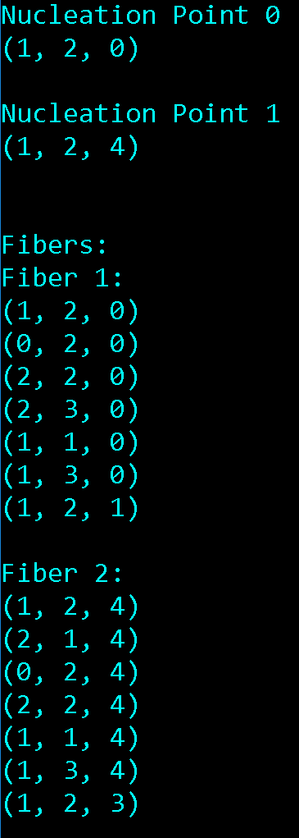
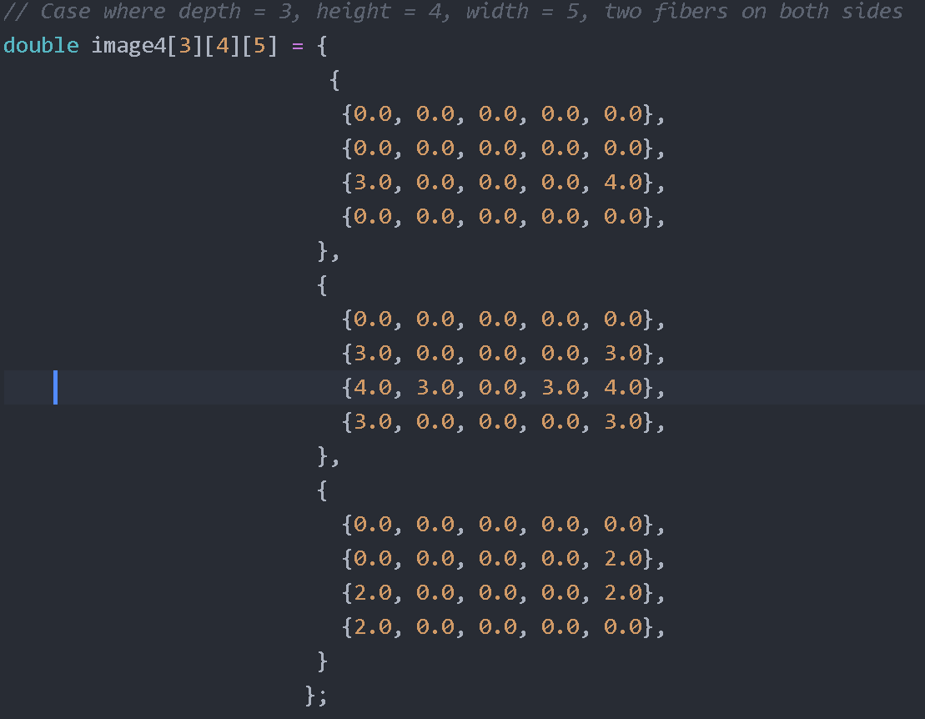
Non-cube images with two fibers

Slide 9
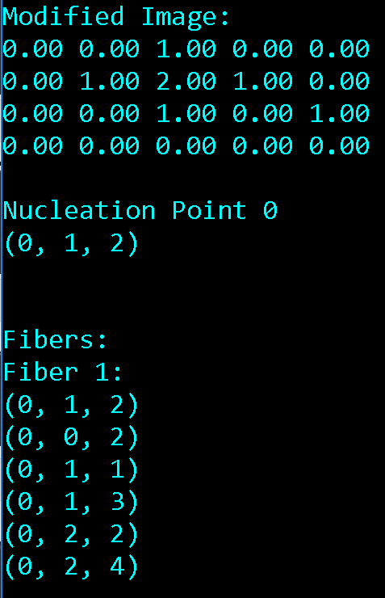
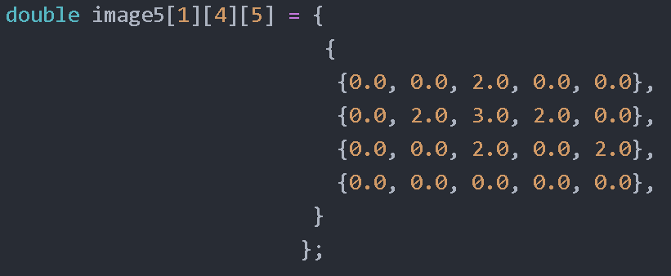
2D image verification/planar fiber

Slide 10
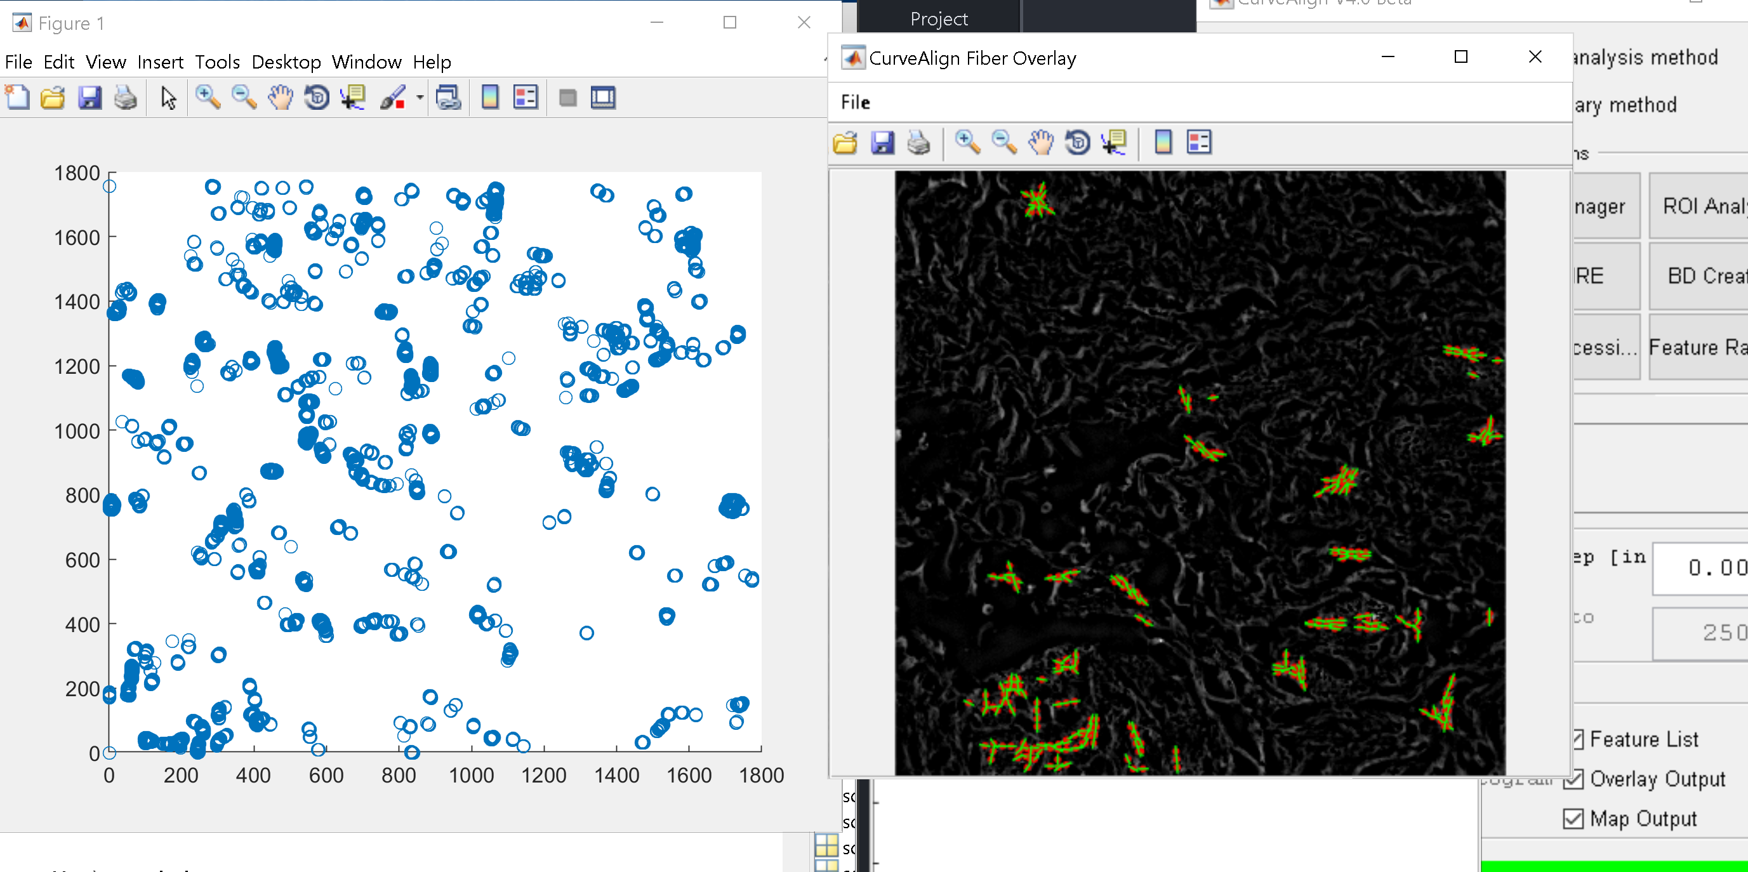
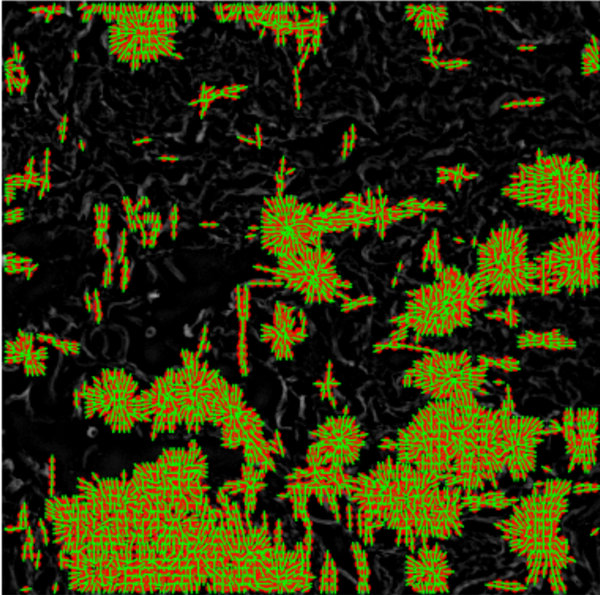
3D FIRE (left) vs CurveAlign (right)
CurveAlign overrepresents fibers if the image is dense. 3D FIRE fails to identify some clusters of fibers.

Slide 11
Next Steps
Refinement of 3D FIRE
Increasing accuracy of finding distance from foreground to background- originally using brute force, optimized it to only look in 6 directions, will try a hybrid of both models
Play around with nucleation, local maximum point, and binary threshold values
Use more robust visualization method
Testing with fluorescent zee stacks of images
Potential speedup on EWS workstations

Slide 12
